Slide 1



*
Chapter Eleven
*
Human Resource Management: Finding and Keeping the Best Employees
McGraw-Hill/Irwin
Copyright © 2010 by the McGraw-Hill Companies, Inc. All rights reserved.

Slide 2
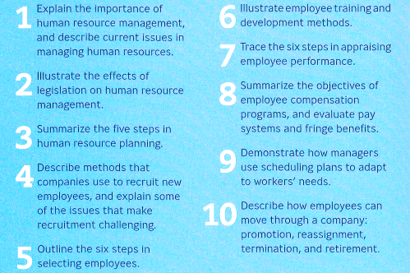
Learning Objectives
*
*
LG1
Notes:
See Learning Goal 1: Explain the importance of human resource management, and describe current issues in managing human resources.

Slide 3


HUMAN RESOURCE MANAGEMENT (HRM)
*
Working with People is Just the Beginning
*
LG1
Definition of HRM:
The process of determining human resource needs and then recruiting, selecting, developing, motivating, evaluating, compensating and scheduling employees to achieve organizational goals.
Notes:
See Learning Goal 1: Explain the importance of human resource management, and describe current issues in managing human resources.

Slide 4

Evolution of HRM
*
Working with People is Just the Beginning
*
LG1
HRM’s role has grown because:
Increased recognition of employees as a resource.
Changes in law that rewrote old workplace practices.
11-4
Notes:
See Learning Goal 1: Explain the importance of human resource management, and describe current issues in managing human resources.

Slide 5
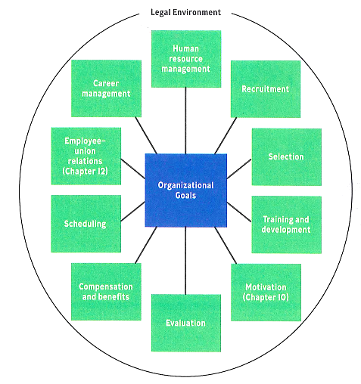
HRM Activities
*
*
Notes:
See Learning Goal 1: Explain the importance of human resource management, and describe current issues in managing human resources.

Slide 6
HRM: Contemporary Issues
*
Working with People is Just the Beginning
*
LG1
Shortage of trained workers
Under-employed workers
Under-educated and unprepared workers
Job loss due to recession, retirement or reduced job loyalty
Rise of single-parent & two-income families
Shift in employee attitude & morale
Growth of Diverse opportunities
Shift in employee attitude
Human Resource Management Sustainability
11-6
Notes:
See Learning Goal 1: Explain the importance of human resource management, and describe current issues in managing human resources.

Slide 7





HRM: Legal Issues
*
*
LG1
HR violations regarding discrimination
Harassment-based employee lawsuits
HR issues with confidentiality
Adhering to Equal Pay Laws
Notes:
See Learning Goal 1: Explain the importance of human resource management, and describe current issues in managing human resources.

Slide 8

Laws affecting HRM Practices: USA
*
*
CIVIL RIGHTS ACT of 1964
1972 EQUAL EMPLOYMENT OPPORTUNITY ACT (EEOA)
CIVIL RIGHTS ACT of 1991 and Office of Federal Contract Compliance Programs (OFCCP)
Americans with Disabilities Act of 1990 (ADA)
Age Discrimination in Employment Act (ADEA)
Notes:
See Learning Goal 1: Explain the importance of human resource management, and describe current issues in managing human resources.

Slide 9




Laws affecting HRM Practice: Bangladesh
*
*
11-9
Notes:
See Learning Goal 1: Explain the importance of human resource management, and describe current issues in managing human resources.

Slide 10

MINDING THE LAW IN HRM
*
Effects of Legislation
*
LG2
Employers must know the law and act accordingly.
Legislation affects all areas of HRM.
Changes in law and legislation occur regularly.
11-10
Notes:
See Learning Goal 2: Illustrate the effect of legislation on human resource management.

Slide 11

Mini Activity
*
*
List down five opportunities and five threats faced by the HR Departments of the local firms of Bangladesh, due to the recent pandemic.
Notes:
See Learning Goal 2: Illustrate the effect of legislation on human resource management.

